Slide 1
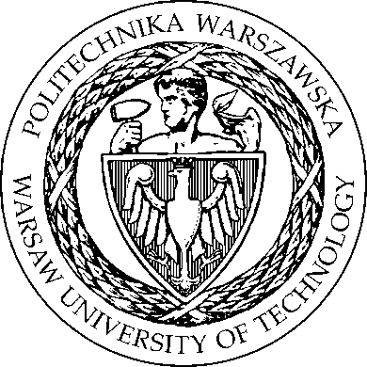
Warsaw University of Technology

Slide 2
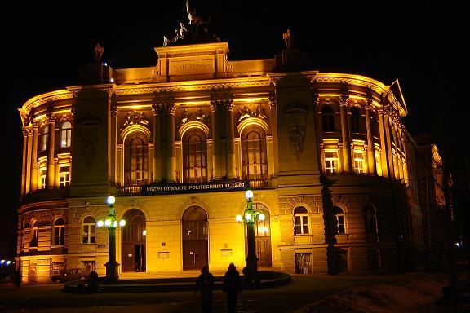
Warsaw University of Technology Main Building

Slide 3
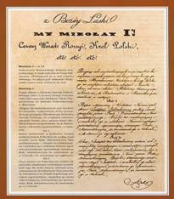
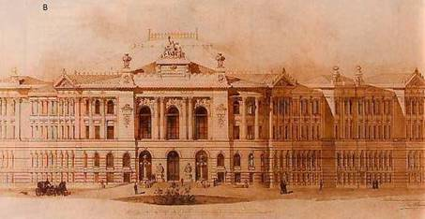
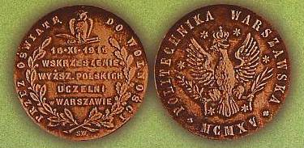
Warsaw University of Technology History
January 4, 1826 - the Preparatory School for the Institute of Technology
June 8, 1898 - Tsar Nikolaus II Institute of Technology
November 15, 1915 - Warsaw University of Technology (with Polish as the language of instruction)

Slide 4
Warsaw University of Technology Localization
WARSAW
Plock

Slide 5
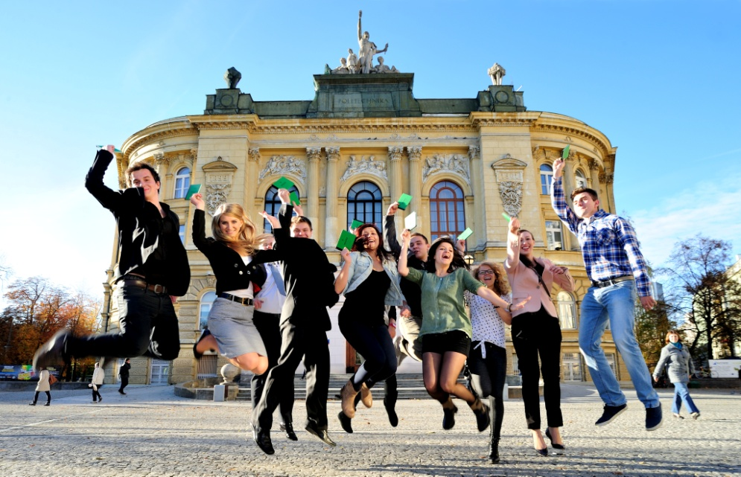
Warsaw University of Technology Facts
WUT – one of the largest
university of technology in Poland
WUT is ranked No. ONE in Poland
among 21 universities of technology
WUT is ranked No. FOUR among all 467 public and private HEIs in Poland
According to the last survey of the largest enterprises in Poland, more than 10% of their CEO’s and Presidents are graduates of WUT!
The graduates of WUT are the most wanted by Polish employers – far ahead before other Polish universities

Slide 6
Warsaw University of Technology 20 Faculties
Faculty of Architecture
Faculty of Automotive and Construction Machinery Engineering
Faculty of Chemical and Process Engineering
Faculty of Chemistry
Faculty of Civil Engineering
Faculty of Electrical Engineering
Faculty of Electronics and Information Technology
Faculty of Environmental Engineering
Faculty of Geodesy and Cartography
Faculty of Mathematics and Information Science
Faculty of Mechatronics
Faculty of Physics
Faculty of Power and Aeronautical Engineering
Faculty of Production Engineering
Faculty of Transport
Faculty of Materials Science and Technology
Faculty of Civil Engineering Mechanics and Petrochemistry (Płock)
Faculty of Management
Faculty of Administration and Social Sciences
College of Economics and Social Sciences (Płock)

Slide 7
Warsaw University of Technology International Business School
Established as a cooperation of four partners:
London Business School (UK)
HEC – School of Management Paris (France)
NHH Norwegian School of Economics
and Business Administration (Norway)
Warsaw University of Technology (Poland)
Postgraduate Master’s programs in Business Administration
(appr. 250 students annually):
Executive MBA
International MBA
Advanced Management Training in Pharmacoeconomics, HTA,
Pharma Marketing and Law
Academy of Leadership Psychology
Family Business Academy

Slide 8
Warsaw University of Technology Other important units
Research Centres:
Centre of Advanced Materials and Technologies (CEZAMAT)
Centre of Preclinical Research and Technology (CePT)
Research Centre for Energy & Environmental Engineering
Research Centre for Functional Materials
Research Centre for Aviation and Aerospace
Research Centre for Defence and Security
Supportive Units:
Centre for Advanced Studies
Centre for Distance Learning (B.Sc., M.Sc. and Post-diploma studies)
Foreign Language Centre
Centre for Physical Education & Sports
Centre for International Cooperation

Slide 9
Warsaw University of Technology Funds
Appr. 70 % - State Budget (Ministry of Science and Higher Education)
Appr. 30 % - Other sources:
International projects,
University revenues,
Industry.
WUT Budget Distribution

Slide 10
Warsaw University of Technology
University Staff
Total: 4 975 employees
Non-academic staff: 2 472 persons (49%)
(lab-technicians, supporting staff, library staff, administration, etc.)
Academic staff: 2 503 persons (51%)
Academic Staff in Percentages:
10

Slide 11
Warsaw University of Technology Students
Total number of students 36 859
Full time students 25 930
Extramural students 8 100
Postdiploma students 1 650
PhD students 1 179
Annual recruitment of students: appr. 8 000

Slide 12
Warsaw University of Technology Fields of studies (programmes in Polish)
Information Technology
Management and Production Engineering
Management
Materials Engineering
Mathematics
Mechanics and Machines Construction
Mechatronics
National Security
Papermaking Technology and Typography
Photonics
Power Engineering
Space Management
Technical Physics
Technical-IT Education
Telecommunications
Transport
Administration
Architecture and Urban Development
Automatics and Robotics
Aviation and Space Technology
Biomedical Engineering
Biotechnology
Chemical and Process Engineering
Chemical Technology
Civil Engineering
Construction
Economics
Electrical and Hybrid Vehicles Engineering
Electrical Technology
Electronics
Environmental Engineering
Environment Protection
Geodesy and Cartography

Slide 13
Warsaw University of Technology Studies in English
Studies in English are being currently offered at 11 Faculties:
Architecture – M.Sc.
Chemistry – M.Sc., EM M.Sc.
Civil Engineering – B.Sc. & M.Sc.
Electronics and Information Technology – B.Sc. & M.Sc.
Electrical Engineering – B.Sc. & M.Sc.
Environmental Engineering – B.Sc. & M.Sc.
Management – M.Sc.
Power and Aeronautical Engineering – B.Sc. & M.Sc., EM M.Sc.
Mathematics and Information Science – B.Sc. & M.Sc.
Production Engineering – M.Sc.
Mechatronics – B.Sc. & M.Sc., EM M.Sc.

Slide 14
Warsaw University of Technology International students 2013/2014
Regular international students ~ 921
studies in Polish (~30%)
studies in English (~70%)
Erasmus Mundus ~ 62
LLP Erasmus (European students) ~ 311
ATHENS (short term courses) ~ 101
Other programs and bilateral exchange ~ 30
All together about ~ 1425
Representing approximately
70 nationalities

Slide 15
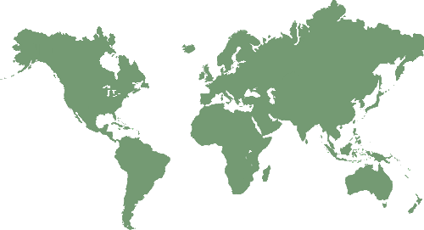
Warsaw University of Technology Cooperation agreements (key examples)
Ecole Nationale Superieure des Mines de Saint-Etienne (France)
ParisTech (France)
Centro Ricerche FIAT SCPA (Italy)
Politecnico di Milano (Italy)
Delft University of Technology (Netherlands)
Maryland University (USA)
University of Detroit Mercy (USA)
Nebraska Lincoln University (USA)
University of Waterloo (Canada)
Queensland University of Technology (Australia)
Technion, Israel Institute of Technology (Israel)
Hanyang University (Rep. of Korea)
Kyungpook National University (Rep. of Korea)
National University of Singapore (Singapore)
Nanyang Technological University (Singapore)
Nagoya University (Japan)
Shizuoka University (Japan)
All together scientific cooperation with 120+ universities, research institutions and high-tech
industries.

Slide 16
Warsaw University of Technology European educational programmes
Erasmus Mundus Action 1 (joint studies):
EMARO – Master Program in Advanced Robotics
M.E.S.C. – Materials for Energy Storage and Conversion
OpSciTech – Optics in Science and Technology
Erasmus Mundus Action 2 (students/staff mobility):
ACTIVE – Armenia, Belarus, Georgia, Moldova, Ukraine
AVEMPACE I, II, III – Middle East
eASTANA – Central Asia
EWENT – Belarus, Moldova, Ukraine
INTERWEAVE – South-East Asia
HERITAGE – India
ICI – ECP
KEUDOS – Korea/UE Degree Opportunities for Students

Slide 17
Warsaw University of Technology Research Priorities
Computer science, ICT, telecommunications
Artificial Intelligence
Biomedical engineering
New material technologies (microelectronics and nanotechnologies
Alternative and renewable energy sources (solar energy and photovoltaics)
Energy saving and storage
Nuclear energy
Environmental engineering
Transport, aviation, space research
Chemistry, chemical technology, functional materials

Slide 18
Warsaw University of Technology European Union Framework Programmes
5th FP – 55 projects
6th FP – 90 projects, 3 as Coordinator
7th FP – 76 projects, 4 as Coordinator
Financial data for 76 contracted projects:
Projects total budget – 472,25 mln EUR
EU funding – 301,48 mln EUR
WUT’s contribution – 20,98 mln EUR
EU funding – 16,59 mln EUR

Slide 19
Warsaw University of Technology Other International Research Programmes/Initiatives
ENIAC JU - European Nanoelectronics Initiative Advisory Council Joint Undertaking
ARTEMIS JU - Joint Undertaking on Advanced Research & Technology for Embedded Intelligence Systems
AAL Programme - Ambient Assisted Living
EUREKA Programme - A Europe-wide Network for Market-Oriented Industrial R&D and Innovation
EUROSTARS Programme
EDA Defence R&T Joint Investment Programme on Force Protection
Projects funded by European Space Agency (ESA)
ERA-NET, ERA-NET+ initiatives
COST Programme

Slide 20
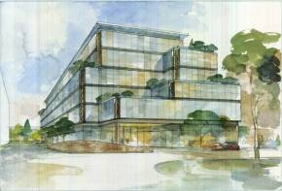
Warsaw University of Technology CEZAMAT – the Centre of Advanced Materials and Technologies
Project co-financed by EU Operational Program for Poland „Innovative Economy”
Agreement signed Sept 2009
Project value – appr. 100 m. €
WUT is Project Coordinator for the
consortium of 9 partners
Location in the southern campus of WUT + decentralized laboratories
The main goal is to conduct interdisciplinary research in fields of micro-, opto-, nano- and bioelectronics, in addition to multifunction micro- and nanomaterials engineering

Slide 21
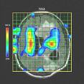
Warsaw University of Technology CePT – the Centre of Preclinical Research and Technology
Project of Biomedical Research Centre, co-financed by EU Operational Program for Poland „Innovative Economy”
Estimated value – appr. 100 m. €
Consortium of 10 partners: Warsaw Medical University, WUT, University of Warsaw and 7 research centers,
All three levels of research (fundamental research, diagnostic and therapy)
More than 120 research projects in the field of:
- nanotechnology,
- molecular biotechnology,
- neurobiology,
- genomics,
- biomedical engineering,
- pharmacology.
21

Slide 22
Warsaw University of Technology Cooperation with industry (key examples)
Siemens AG (Germany & Poland)
PKN Orlen SA (Poland)
BASF (Germany)
General Electric (USA)
Pratt&Whitney (USA)
ABB Ltd (Switzerland)
Carl Zeiss (Germany)
Autodesk (USA)
Cummins Filtration (USA)
FIAT (Italy & Poland )
Telekomunikacja Polska S.A., (Poland) & France Telecom (France)
LG Electronics (Korea & Poland)
SAMSUNG (Korea & Poland)
AREVA (France)
Zdjęcie za www.orlen.pl

Slide 23
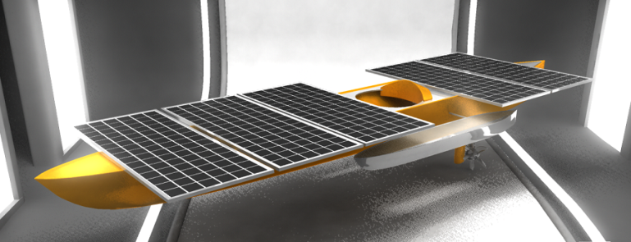
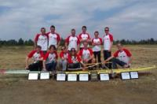
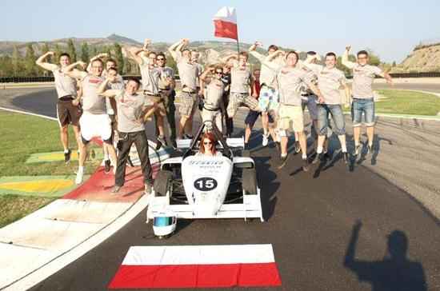
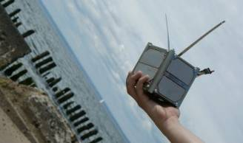
Warsaw University of Technology Students’ achievements
over 100 students research groups
PW-Sat – first Polish satellite developed by students, launched to the orbit in 2013.
WUT Solar Boat - an innovative project of building solar powered boat.
WUT Racing - a project of designing and building students’ F1 bolid.
Aero Design 2013 - first team in the history of the competition, WUT students took the first three places as overall winners in each class.

Slide 24
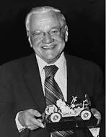
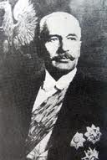
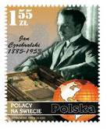
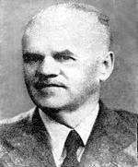
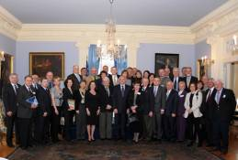
Warsaw University of Technology Our Alumni
The famous alumni and Professors:
Ignacy Mościcki (Prof., Chemistry, the President of Poland 1926-1939),
Jan Czochralski (Prof., Chemistry, inventor of
semiconductor production process)
Mieczysław Wolfke (Prof. Optics, precursor in the
development of holography)
Mieczyslaw Bekker (Prof. Mechanics,
author of general idea, design and construction of the lunar vehicles LRV
for missions Apollo 15, 16 and 17
The famous Doctors Honoris Causa: Maria Skłodowska-Curie (Nobel Prize Winner), Jan Czochralski, Ignacy Mościcki, Antoni K. Oppenheim (Prof., Mechanics, world's leading combustion expert)
The Association of WUT Alumni
and Friends – www.saip.pw.edu.pl
The North-American Association of WUT Alumni

Slide 25
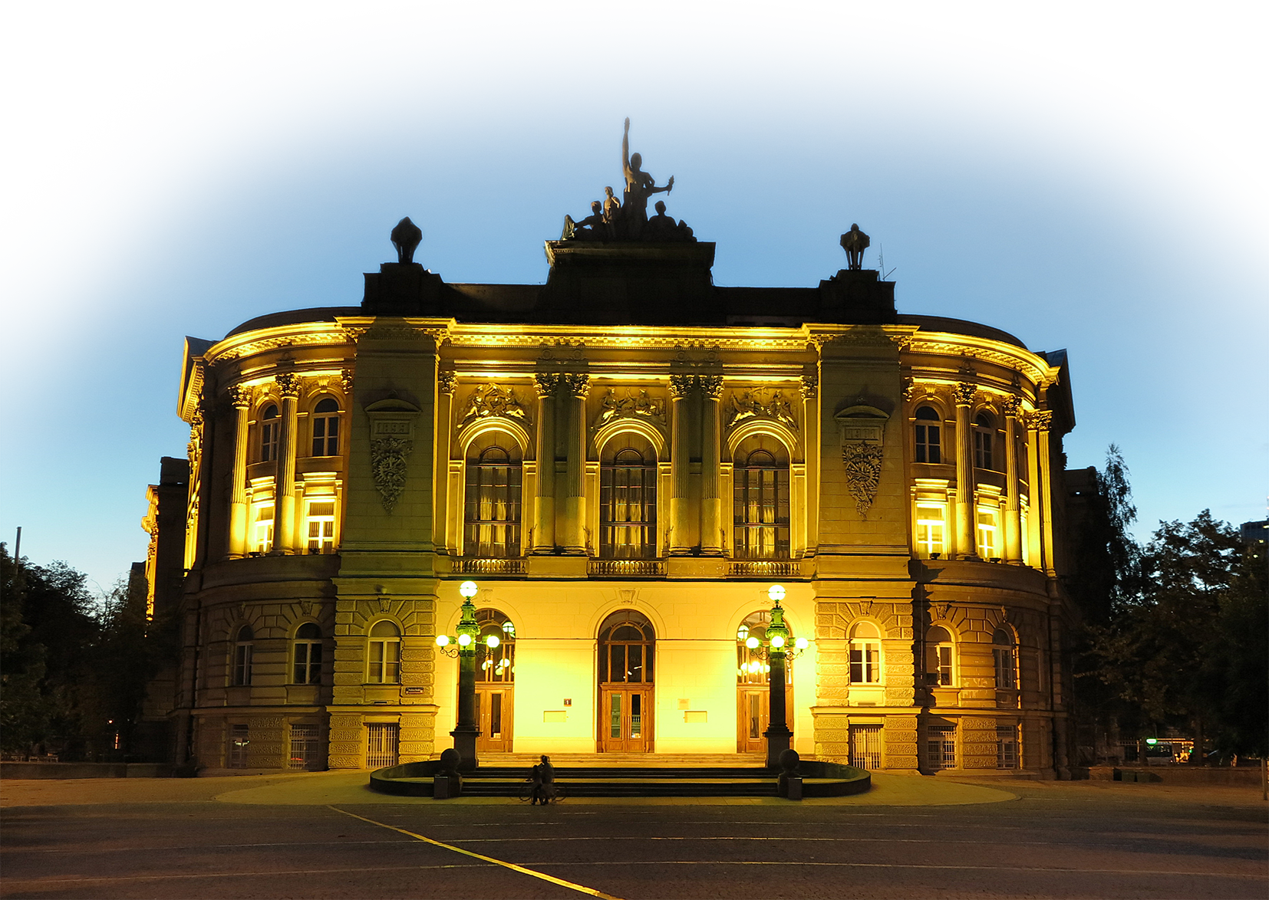
Politechnika Warszawska
www.cwm.pw.edu.pl www.pw.edu.pl

